Slide 1
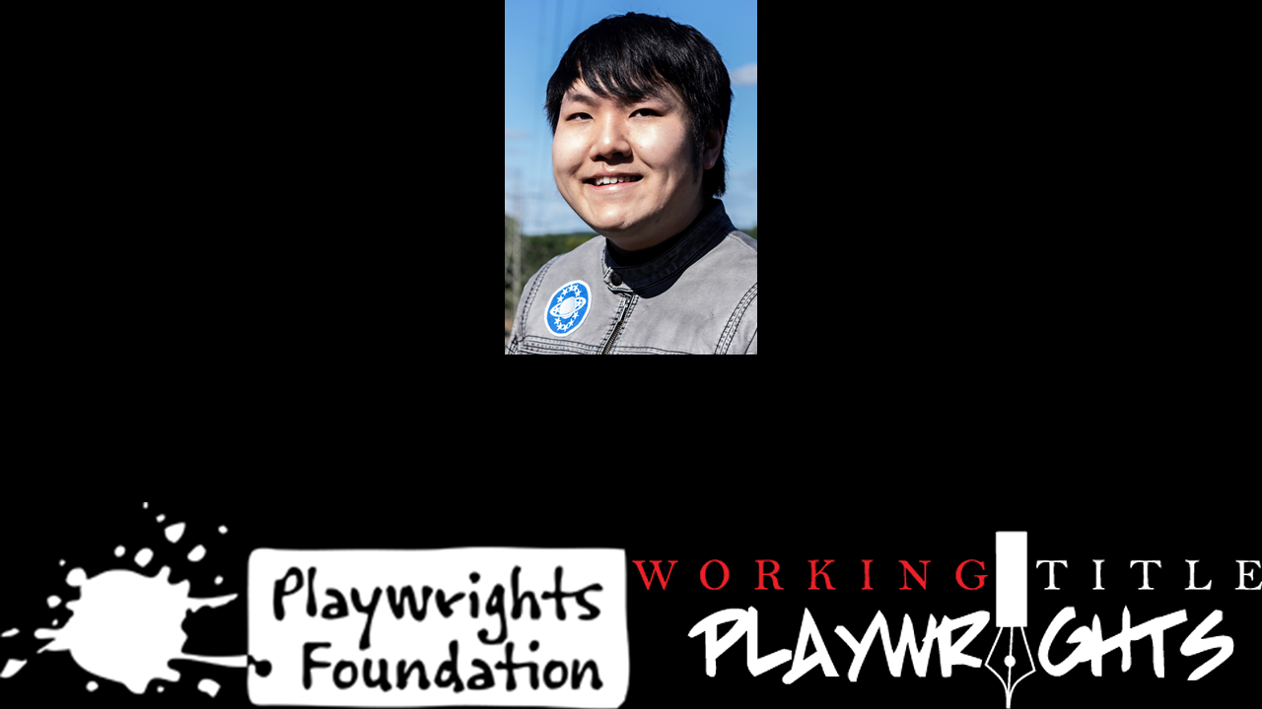
David Quang Pham
Literary Fellow
Musical Writer
…
Notes:
Hello [ ]. Hope you and yours are doing well. My name is David (he/him) and I reside on the traditional land of the Odawa people in Michigan. I am the Literary Fellow of Playwrights Foundation, the leading new play organization in the Bay Area. I am also a professional musical writer. And in the ellipsis, I am most faithfully…

Slide 2
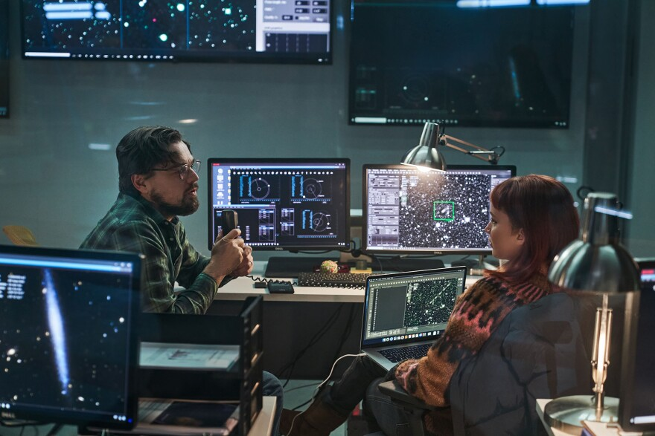

David Quang Pham
Literary Fellow
Musical Writer
Science Producer
Notes:
0) A science producer. After all, I am a scientist. In particular, I have an astrophysics background. Fun fact: My alma mater is Michigan State University
1) where I looked up at the sky with these two. Anyways, I study our Universe as an astrophysicist. I personify their verse as a musical dramatist. I’m the exact person you want writing a family musical…

Slide 3
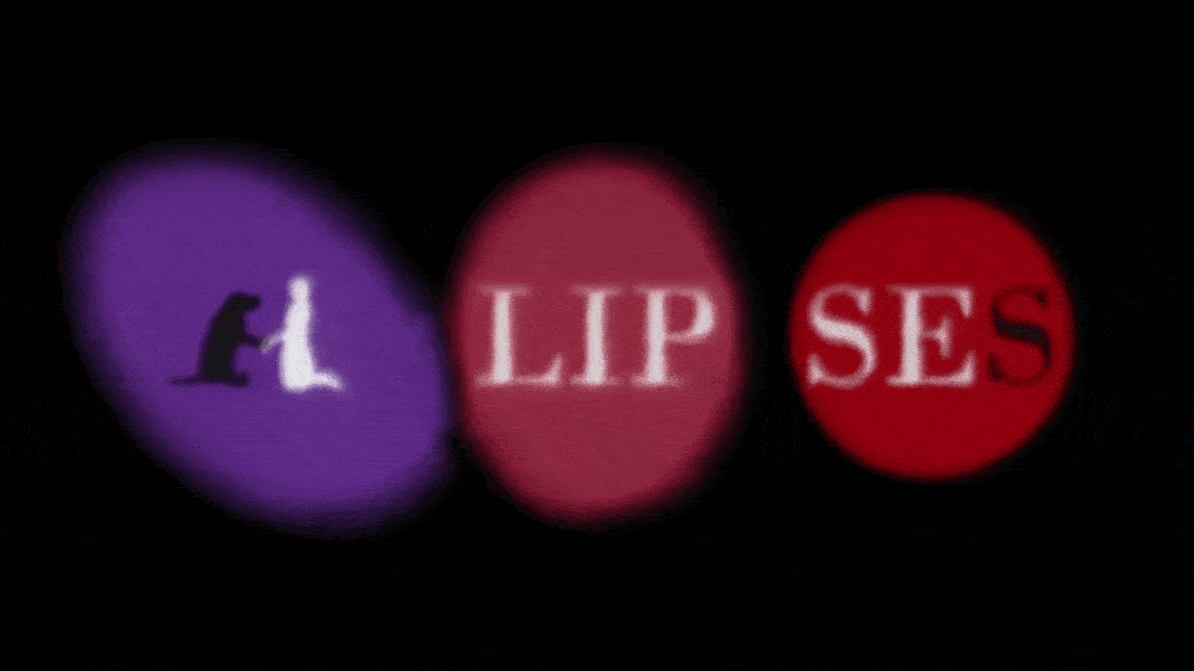
Notes:
…about Galaxies!

Slide 4


Book, Music, & Lyrics by
David Quang Pham
davidquangpham@outlook.com
ellipsesplay.com @EllipsesPlay
Notes:
Meet the Galaxy family. I’ll let the music do their talking.

Slide 5
A Universal Musical
This family drama of epic proportions centers on the Galaxy family and their dog Gravity as they face a life-changing event known as the Big Bang. The hero of the story unleashes the Big Bang in order to run away from home.
Book, Music, & Lyrics by
David Quang Pham
davidquangpham@outlook.com
ellipsesplay.com @EllipsesPlay
Notes:
Sound familial?
ELLIPSES is literally a universal musical. This family drama of epic proportions centers on the Galaxy family and their dog Gravity as they face a life-changing event known as the Big Bang. The hero of the story unleashes the Big Bang in order to run away from home. What the protagonist simply wants to do is explore the Universe, but their parent has a stronghold on them and their siblings.

Slide 6
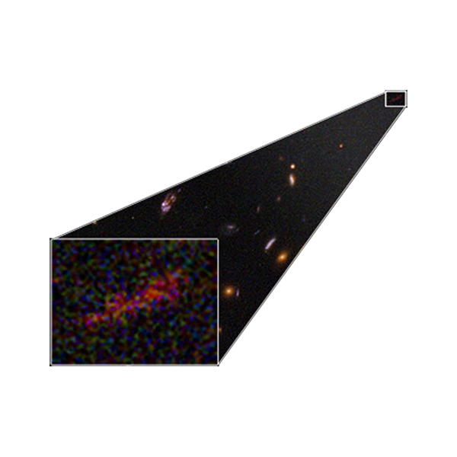
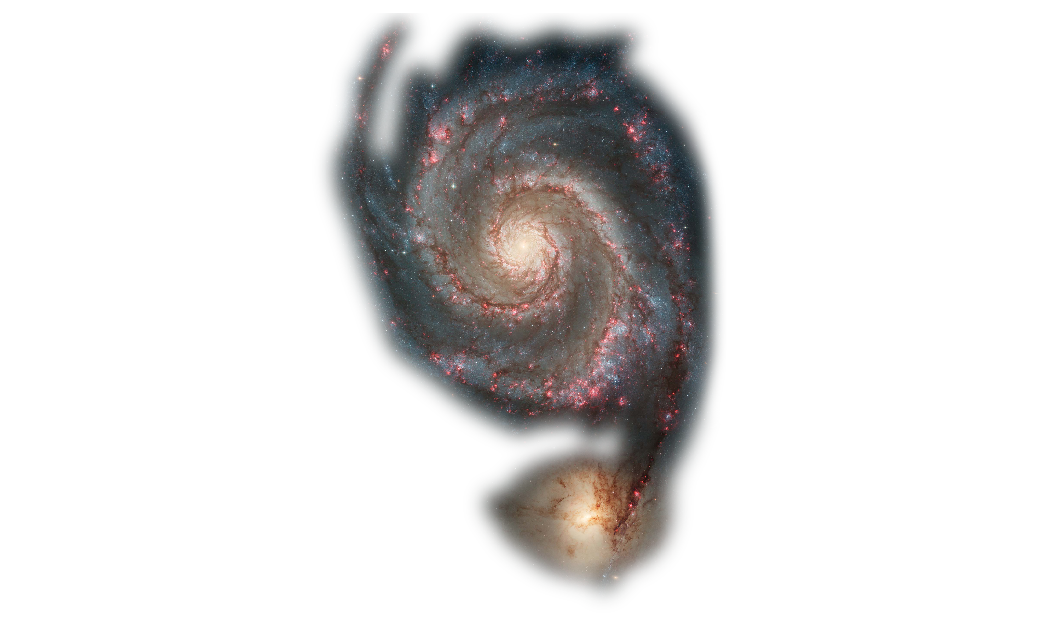
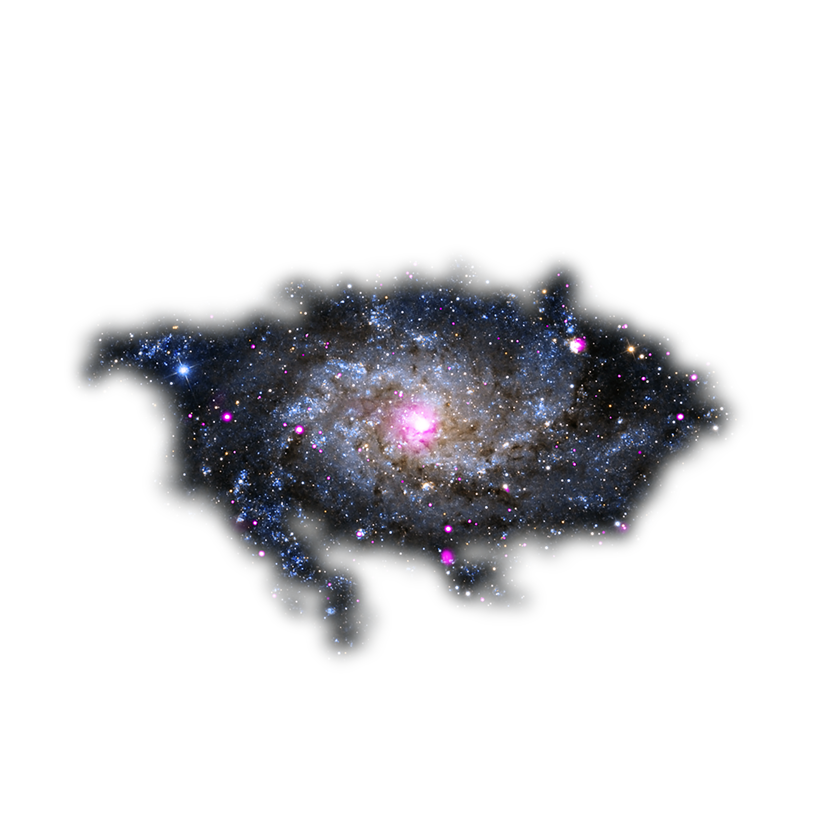
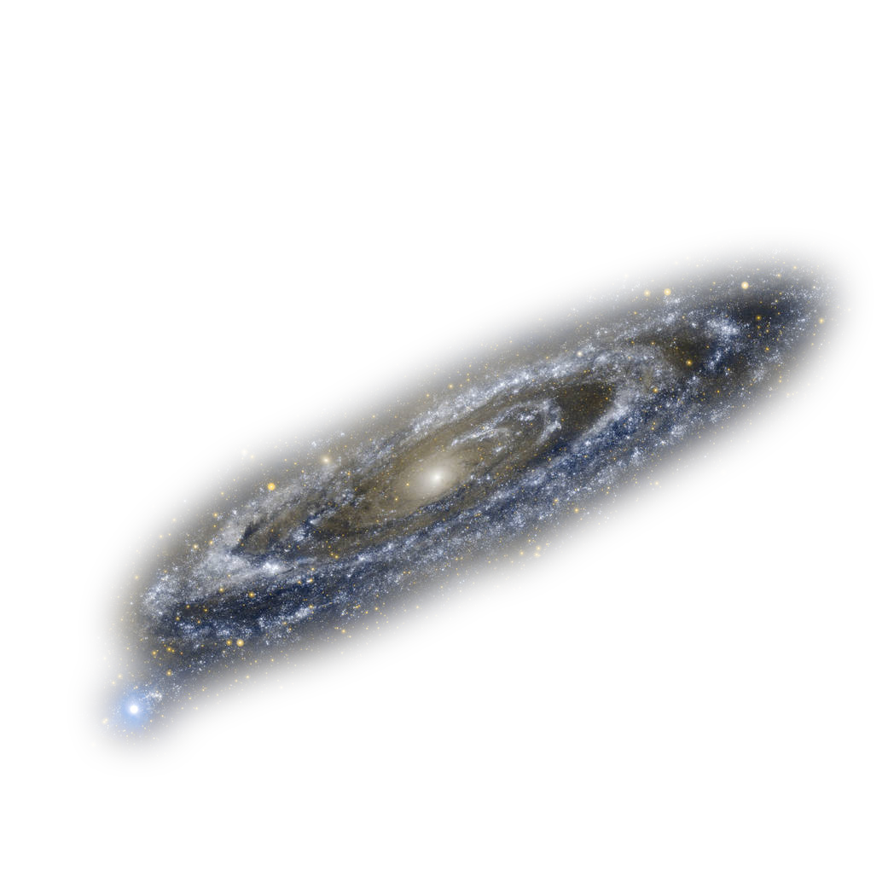
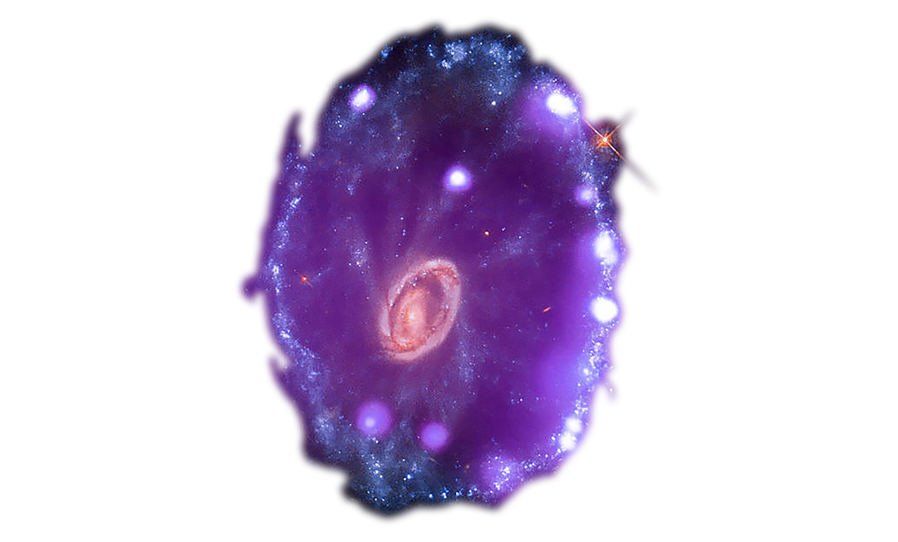

Cast
o 8 Principal Characters (The Galaxy Family)
o Singularity, the single parent of six Galaxies
o 6 Galaxies (JD, Cartwheel, Whirlpool, Triangulum, Andromeda, Milky Way)
o Gravity, the family dog
o Flexible Ensemble (Dogs, Solar System Objects)
Book, Music, & Lyrics by
David Quang Pham
davidquangpham@outlook.com
ellipsesplay.com @EllipsesPlay
Notes:
0) The Galaxy family and their dog Gravity are the principal characters
1) Singularity is the single parent of six children. Singularity is single.
2) Their six children are JD, Cartwheel, Whirlpool, Triangulum, Andromeda, and Milky Way. They are named after real Galaxies.
3) And Gravity is the family dog who constantly lets the family down.
4) Then a flexible ensemble of other dogs and celestial objects.
Together, their voices make up an…

Slide 7
Music (POPERA)
o Pop o Chinese Opera o Punk o Psychedelia
“The music is a character in its own right… feels like it was written before time existed.”
- Zeniba Now, Award-Winning Musical Writer & Art Scientist
“I compare it to American Idiot through the lens of Katamari Damacy.”
- Liz Dooley, Dramaturg & Playwright
Book, Music, & Lyrics by
David Quang Pham
davidquangpham@outlook.com
ellipsesplay.com @EllipsesPlay
Notes:
Epic Popera. The genres are a) pop because I am Generation Z and grew up on Madonna who made music an hour away; b) Chinese opera as my family watched Kunqu operas and Kabuki theatre; c) punk because all my college roommates were in punk bands; and d) a bit of psychedelia. I was in the orchestra pit of Hair. I fuse these genres to give the audience a mixed experience where the music speaks ancestrally and yet leads them into the future. And broadens the possibilities of choreography. And it makes us gravitate to ELLIPSES’s core idea and messages.

Slide 8
What is an ellipse…? What are ellipses…?
Geometry Lesson! Grammar Lesson!
…
Book, Music, & Lyrics by
David Quang Pham
davidquangpham@outlook.com
ellipsesplay.com @EllipsesPlay
Notes:
0) So why the name?
1) Everyone took geometry and English, but we all need refreshers.
2) In geometry, an ellipse is an oval. Ellipses are ovals. In grammar, ellipses are the triple periods that you see in texts to imply omission, where you have to fill the blank. In terms of shape, Galaxies are ellipses. In terms of punctuation, ellipses say there are hidden meanings in the omission. Put that together, and you get the outer space that we know.

Slide 9
An Elliptical Message
What does nothingness do for someone?
“Nothing” leaves space for “Everything.”
“Nothing” makes room for “Everything.”
Key: Family is Everything (you know).
Book, Music, & Lyrics by
David Quang Pham
davidquangpham@outlook.com
ellipsesplay.com @EllipsesPlay
Notes:
This two-hour musical spans quintillions of years before the beginning of time to the very end of time. In the expanse of space, the core idea of nothingness is explored. That is what the children, who took Everything for granted, learn once they are separated from Singularity after the Big Bang. ♬ Family is Everything you know. ♬

Slide 10
Entangling this with the Science!
The world needs stories about the importance of connections while embracing science. Science is more important than ever before; there are people who do not believe in science. Perhaps, it is because scientific principles are not represented in human qualities. David’s use of personification in a narrative format looks to bridge humanity and galaxies.
Book, Music, & Lyrics by
David Quang Pham
davidquangpham@outlook.com
ellipsesplay.com @EllipsesPlay
Notes:
But back to the science! The world needs stories about the importance of connections while embracing science. Science is more important than ever before; there are people who do not believe in science. Perhaps, it is because scientific principles are not represented in human qualities. My use of personification in a narrative format looks to bridge humanity and galaxies. I want the audience to come out of the show realizing that they are Galaxies themselves.

Slide 11


Development
o 2020-21: Working Title Playwrights Apprenticeship
o 4 Readings with Talkback
o July 2021: Concert Reading with Talkback
o Raised $2020 from 13 donors
o 2021-22: Theater Resources Unlimited
o 3 Musical Workshops
o December 2021: Director Lab
Book, Music, & Lyrics by
David Quang Pham
davidquangpham@outlook.com
ellipsesplay.com @EllipsesPlay
Notes:
For the past years, this story goes through heavy developments thanks to my apprenticeship at Working Title Playwrights, the leading new play organization in Atlanta. Their members helped raise over $2000 for our virtual concert and reading. TRU also selected us for their quarterly musical workshops. ELLIPSES has a total of two hours of talkback. This doesn’t include feedback from these stellar theatre artists…

Slide 12


Jordan Alexandria ealey
ELLIPSES Dramaturg | jordanealey.com
Notes:
Jordan Alexandria Ealey, now dramaturg of We Won't Sleep by Ari Afsar and Lauren Gunderson at Signature Theatre.

Slide 13
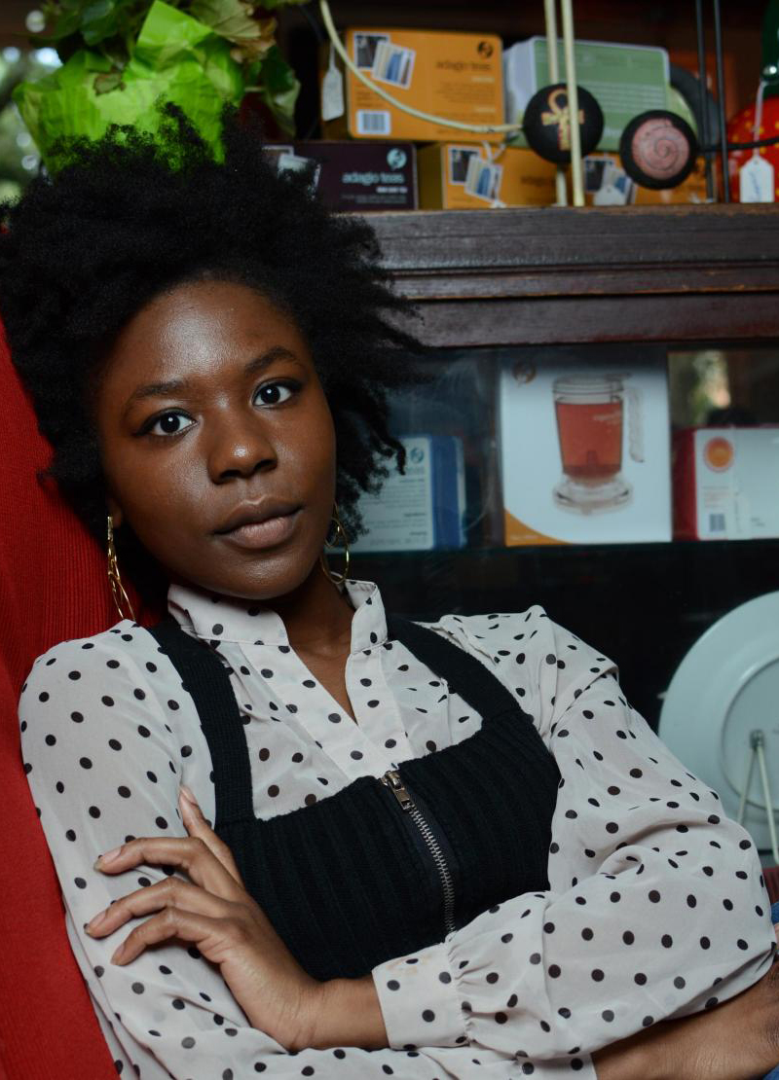

ALIYAH CURRY
ELLIPSES Director | theirdaughters.productions
Notes:
Aliyah Curry, a director and award-winning filmmaker.

Slide 14

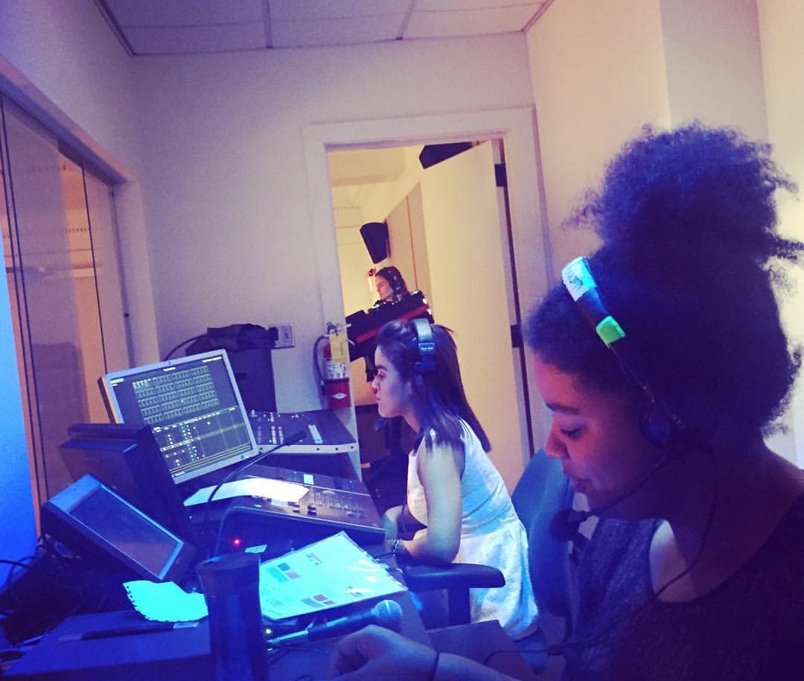
Alexis ‘Lexi’ McKay
ELLIPSES Stage Manager
Notes:
Lexi McKay, a stage manager of Hamilton on tour in Atlanta.

Slide 15
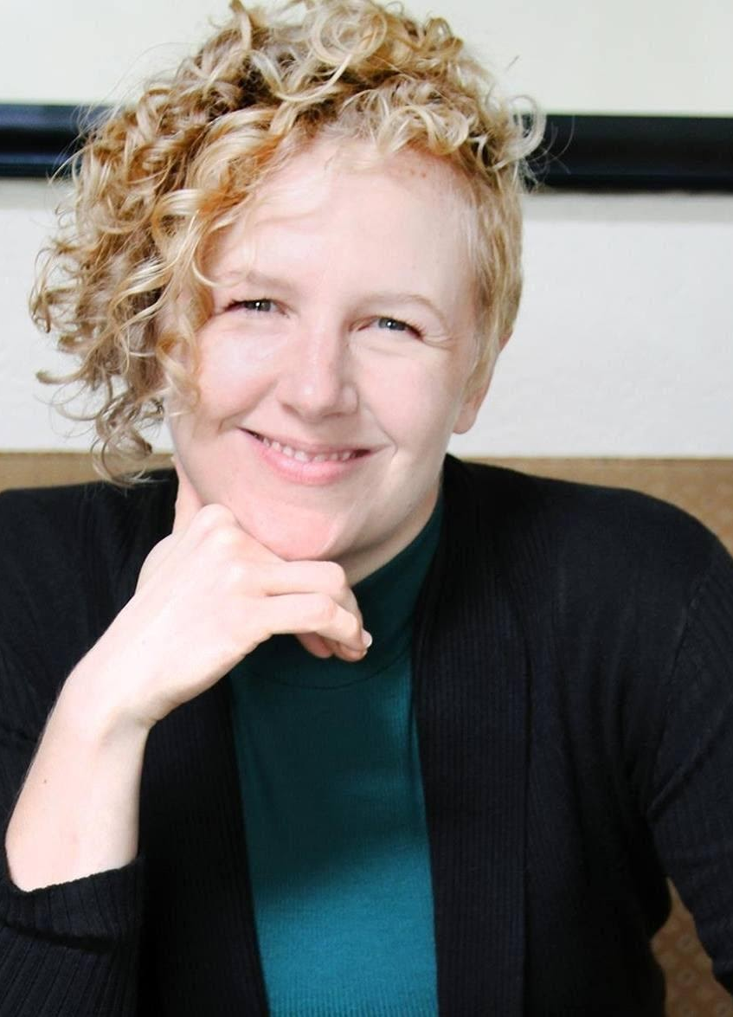
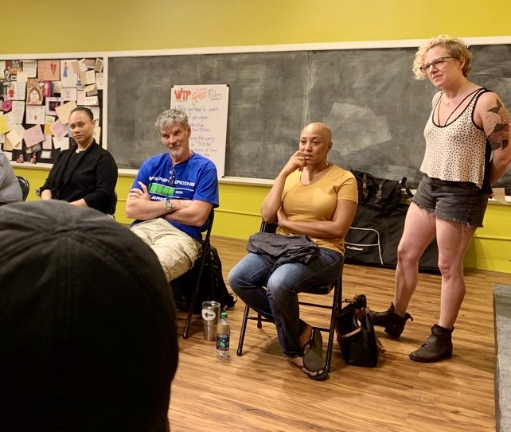
Amber Bradshaw
The Managing Artistic Director of Working Title Playwrights
Notes:
And Amber Bradshaw, who believed in this musical and me. Because of these great honors, ELLIPSES is now currently…

Slide 16

Next Steps
o Apply for more developmental programs
o ELLIPSES is a current 2022 O’Neill Semifinalist
o Development in the collegiate circuit
o Looking to connect with universities’ theatre and astronomy departments
Book, Music, & Lyrics by
David Quang Pham
davidquangpham@outlook.com
ellipsesplay.com @EllipsesPlay
Notes:
A 2022 semifinalist for the National Music Theater Conference at the Eugene O’Neill Theater Center.
My next steps are to apply to more developmental programs such as Apples and Oranges’s THEatre ACCELERATOR and my alma mater’s ĭmáGen program at Michigan State.
I am looking at other universities that do STEM-performing arts collaborations, such as Emory University, Boston University, University of Iowa. I am looking for more colleges to send the script, quality tracks, footages of readings, pitch deck, investor’s package. I need help on gaining physical assets such as concerts and in-person activities.
If you know faculties or you’re interested in the materials, you may reach me at my email.

Slide 17
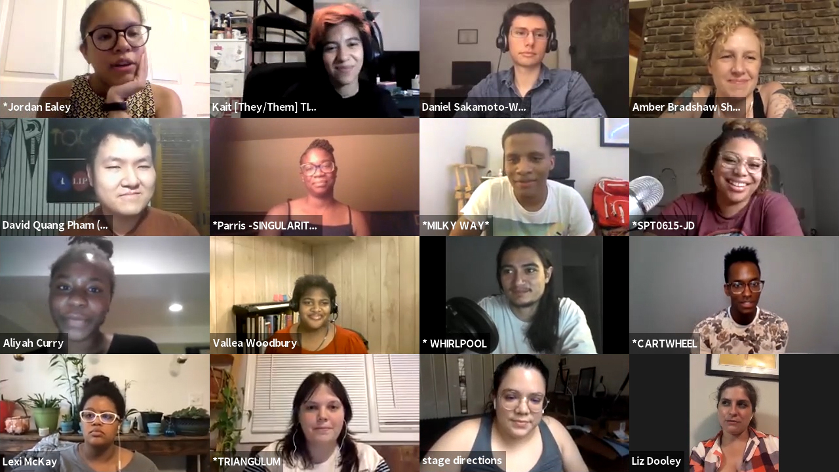
Book, Music, & Lyrics by
David Quang Pham
davidquangpham@outlook.com
ellipsesplay.com @EllipsesPlay
Notes:
Again, thank you to our yearlong star-studded team of 16 theatre professionals.

Slide 18
Unique!
“I absolutely love this idea. The idea about a universe that’s a family drama… How incredible is that… It’s very unique and very original.”
- Paul Gordon, Composer/Lyricist of Jane Eyre and Daddy Long Legs
“I love stories about families and this is truly the most unique I've seen.”
- John Mabey, Award-Winning Playwright
Book, Music, & Lyrics by
David Quang Pham
davidquangpham@outlook.com
ellipsesplay.com @EllipsesPlay
Notes:
And 60 guests who attended our reading. Here are some of their quotes, which emphasized family. Speaking of family, we will close out with the showtune that you heard earlier in our trailer that we premiered last year.

